Slide 1
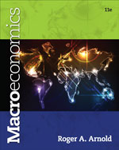
Chapter 2: Production Possibilities Frontier Framework
© 2014 Cengage Learning. All Rights Reserved. May not be copied, scanned, or duplicated, in whole or in part, except for use as permitted in a license distributed with certain product , service, or otherwise on password-protected website for classroom use

Slide 2

In this Lecture
  An Economy’s Production Possibilities Frontier
  Increasing and Constant Opportunity Costs
  The Production Possibilities Frontier and Various Economic Concepts
  Specialization, Trade and the PFF
To select a topic, click on its link above
© 2014 Cengage Learning. All Rights Reserved. May not be copied, scanned, or duplicated, in whole or in part, except for use as permitted in a license distributed with certain product , service, or otherwise on password-protected website for classroom use

Slide 3
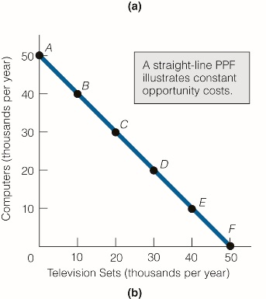

Production Possibilities Frontier
Represents the possible combinations
of two goods that can be produced in
a certain period of time under the
conditions of a given state of
technology and fully employed
resources.
Click for Tutorial
Click to return to “In this Lesson”
© 2014 Cengage Learning. All Rights Reserved. May not be copied, scanned, or duplicated, in whole or in part, except for use as permitted in a license distributed with certain product , service, or otherwise on password-protected website for classroom use

Slide 4
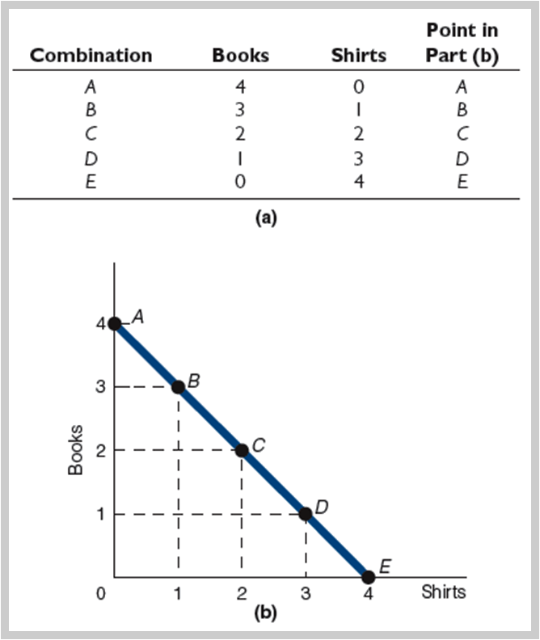
Production Possibilities Frontier
Constant Opportunity Costs
The economy can produce any of the five combinations of books and shirts in part (a).
We have plotted these combinations in part (b). The production possibilities frontier (PPF) in part (b) is a straight line because the opportunity cost of producing either good is constant.
Click to return to “In this Lesson”
© 2014 Cengage Learning. All Rights Reserved. May not be copied, scanned, or duplicated, in whole or in part, except for use as permitted in a license distributed with certain product , service, or otherwise on password-protected website for classroom use

Slide 5
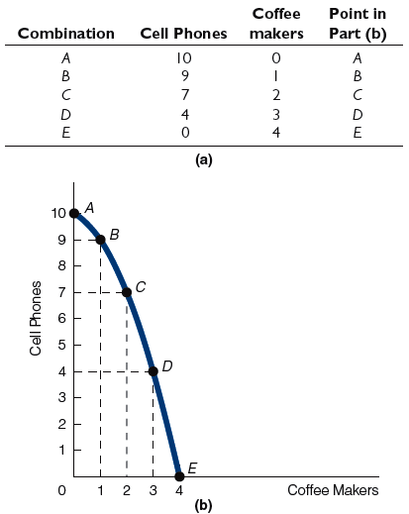
Production Possibilities Frontier
Increasing Opportunity Costs
The economy can produce any of the five combinations of cell phones and coffee makers in part (a).
We have plotted these combinations in part (b).
The production possibilities frontier in part (b) is bowed outward because the opportunity cost of producing coffee makers increases as more coffee makers are produced.
Click to return to “In this Lesson”
© 2014 Cengage Learning. All Rights Reserved. May not be copied, scanned, or duplicated, in whole or in part, except for use as permitted in a license distributed with certain product , service, or otherwise on password-protected website for classroom use

Slide 6
Law of Increasing Opportunity Costs
As more of a good is produced, the
opportunity costs of producing that
good increase
Click to return to “In this Lesson”
© 2014 Cengage Learning. All Rights Reserved. May not be copied, scanned, or duplicated, in whole or in part, except for use as permitted in a license distributed with certain product , service, or otherwise on password-protected website for classroom use

Slide 7
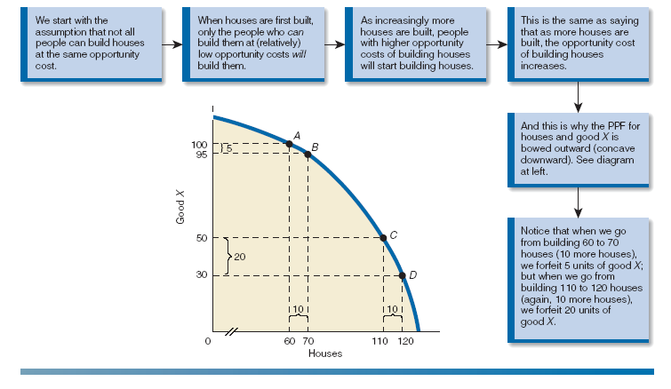
Increasing Opportunity Costs
Click to return to “In this Lesson”
© 2014 Cengage Learning. All Rights Reserved. May not be copied, scanned, or duplicated, in whole or in part, except for use as permitted in a license distributed with certain product , service, or otherwise on password-protected website for classroom use

Slide 8
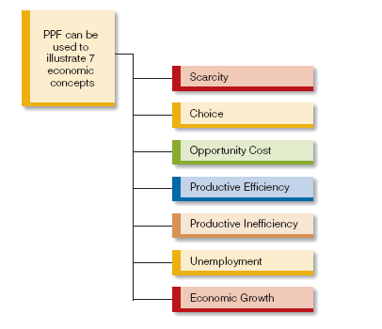
Production Possibility Frontier
Framework for Understanding
Click to return to “In this Lesson”
© 2014 Cengage Learning. All Rights Reserved. May not be copied, scanned, or duplicated, in whole or in part, except for use as permitted in a license distributed with certain product , service, or otherwise on password-protected website for classroom use

Slide 9
Productive Efficiency and Inefficiency
Productive Efficiency
The condition where the maximum output is
Produced with given resources and technology
Productive Inefficiency
The condition where less than the maximum
output is produced with given resources and
technology. Productive inefficiency implies that
more of one good can be produced without any
less of another good being produced.
Click to return to “In this Lesson”
© 2014 Cengage Learning. All Rights Reserved. May not be copied, scanned, or duplicated, in whole or in part, except for use as permitted in a license distributed with certain product , service, or otherwise on password-protected website for classroom use

Slide 10

Technology
Technology is the body of skills and knowledge involved in the use of resources in production
An advance in technology commonly refers to the ability to produce more output with a fixed amount of resources or the ability to produce the same output with fewer resources.
Click to return to “In this Lesson”
© 2014 Cengage Learning. All Rights Reserved. May not be copied, scanned, or duplicated, in whole or in part, except for use as permitted in a license distributed with certain product , service, or otherwise on password-protected website for classroom use

Slide 11
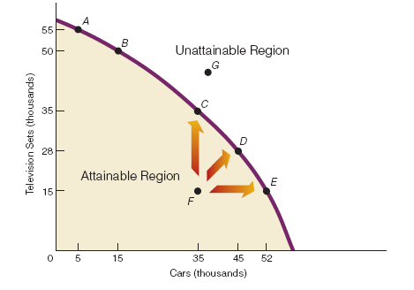
Attainable and Unattainable Regions and Productive Efficiency
Click to return to “In this Lesson”
© 2014 Cengage Learning. All Rights Reserved. May not be copied, scanned, or duplicated, in whole or in part, except for use as permitted in a license distributed with certain product , service, or otherwise on password-protected website for classroom use

Slide 12
The PPF and Various Economic Concepts I
(1) Scarcity is illustrated by the frontier itself. Implicit in the concept of scarcity is the idea that we can have some things but not all things. The PPF separates an attainable region from an unattainable region.
(2) Choice is represented by our having to decide among the many attainable combinations of the two goods. For example, will we choose the combination of goods represented by point A or by point B?
Click to return to “In this Lesson”
© 2014 Cengage Learning. All Rights Reserved. May not be copied, scanned, or duplicated, in whole or in part, except for use as permitted in a license distributed with certain product , service, or otherwise on password-protected website for classroom use

Slide 13
The PPF and various Economic Concepts II
(3) Opportunity cost is most easily seen as movement from one point to another, such as movement from point A to point B. More cars are available at point B than at point A, but fewer television sets are available. In short, the opportunity cost of more cars is fewer television sets.
(4) Productive efficiency is represented by the points on the PPF (such as AE), while productive inefficiency is represented by any point below the PPF (such as F ).
Click to return to “In this Lesson”
© 2014 Cengage Learning. All Rights Reserved. May not be copied, scanned, or duplicated, in whole or in part, except for use as permitted in a license distributed with certain product , service, or otherwise on password-protected website for classroom use

Slide 14
The PPF and various Economic Concepts III
(5) Unemployment (in terms of resources being unemployed) exists at any productive inefficient point (such as F ), whereas resources are fully employed at any productive efficient point (such as AE).
Click to return to “In this Lesson”
© 2014 Cengage Learning. All Rights Reserved. May not be copied, scanned, or duplicated, in whole or in part, except for use as permitted in a license distributed with certain product , service, or otherwise on password-protected website for classroom use

Slide 15
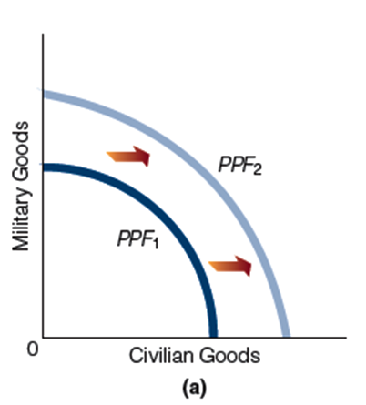
Economic Growth within a PPF Framework
An increase in resources or an advance in technology can increase the production capabilities of an economy, leading to economic growth and shift outward in the production possibilities frontier.
Click to return to “In this Lesson”
© 2014 Cengage Learning. All Rights Reserved. May not be copied, scanned, or duplicated, in whole or in part, except for use as permitted in a license distributed with certain product , service, or otherwise on password-protected website for classroom use

Slide 16
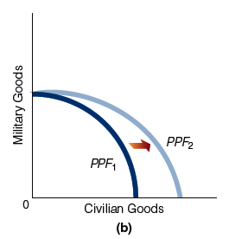
Economic Growth within a PPF Framework
If the advance in technology leads to the greater production of only one good (such as civilian goods in our exhibit), then the PPF shifts outward, as shown in (b).
Click to return to “In this Lesson”
© 2014 Cengage Learning. All Rights Reserved. May not be copied, scanned, or duplicated, in whole or in part, except for use as permitted in a license distributed with certain product , service, or otherwise on password-protected website for classroom use

Slide 17
Self Test
1. What does a straight-line production possibilities frontier (PPF) represent? What does a bowed-outward PPF represent?
A straight-line PPF represents constant opportunity costs between two goods. For example, for every unit of X produced, one unit of Y is forfeited. A bowed-outward PPF represents increasing opportunity costs. For example, we may have to forfeit one unit of X to produce the eleventh unit of Y, but we have to forfeit two units of X to produce the one hundredth unit of Y.
Click to return to “In this Lesson”
© 2014 Cengage Learning. All Rights Reserved. May not be copied, scanned, or duplicated, in whole or in part, except for use as permitted in a license distributed with certain product , service, or otherwise on password-protected website for classroom use

Slide 18
Self Test
2. What does the law of increasing costs have to do with a bowed-outward PPF?
A bowed-outward PPF is representative of increasing costs. In short, the PPF would not be bowed outward if increasing costs did not exist.
Click to return to “In this Lesson”
© 2014 Cengage Learning. All Rights Reserved. May not be copied, scanned, or duplicated, in whole or in part, except for use as permitted in a license distributed with certain product , service, or otherwise on password-protected website for classroom use

Slide 19
Self Test
3. A politician says, “If you elect me, we can get more of everything we want.” Under what condition(s) is the politician telling the truth?
The first condition is that the economy is currently operating below its PPF. It is possible to move from a point below the PPF to a point on the PPF and get more of all goods. The second condition is that the economy’s PPF shifts outward.
Click to return to “In this Lesson”
© 2014 Cengage Learning. All Rights Reserved. May not be copied, scanned, or duplicated, in whole or in part, except for use as permitted in a license distributed with certain product , service, or otherwise on password-protected website for classroom use

Slide 20
Self Test
4. In an economy, only one combination of goods is productive efficient. True or false? Explain your answer.
False. There are numerous productive efficient points, all of which lie on the PPF.
Click to return to “In this Lesson”
© 2014 Cengage Learning. All Rights Reserved. May not be copied, scanned, or duplicated, in whole or in part, except for use as permitted in a license distributed with certain product , service, or otherwise on password-protected website for classroom use

Slide 21
Exchange or Trade
Comparative Advantage
The situation where someone can produce a good at lower opportunity cost than someone else can.
Specialization
Producing goods in which you have a comparative advantage
Click to return to “In this Lesson”
© 2014 Cengage Learning. All Rights Reserved. May not be copied, scanned, or duplicated, in whole or in part, except for use as permitted in a license distributed with certain product , service, or otherwise on password-protected website for classroom use

Slide 22
A Timeline for Trade
Ex Ante - Phrase that means before,” as in before a trade.
Ex Post - Phrase that means “after,” as in after a trade.
Click to return to “In this Lesson”
© 2014 Cengage Learning. All Rights Reserved. May not be copied, scanned, or duplicated, in whole or in part, except for use as permitted in a license distributed with certain product , service, or otherwise on password-protected website for classroom use

Slide 23
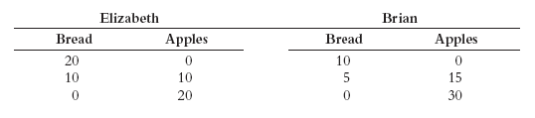
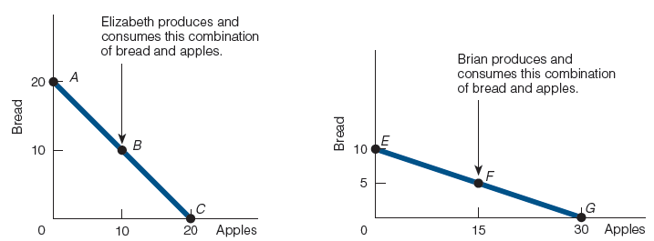
Ex Ante
Elizabeth and Brian Before the Trade
Click to return to “In this Lesson”
© 2014 Cengage Learning. All Rights Reserved. May not be copied, scanned, or duplicated, in whole or in part, except for use as permitted in a license distributed with certain product , service, or otherwise on password-protected website for classroom use

Slide 24
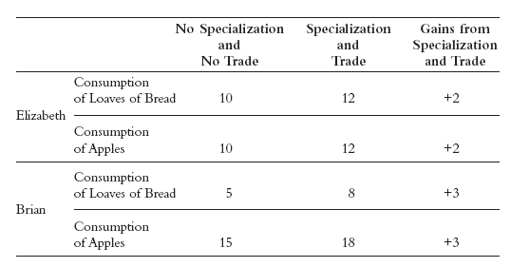
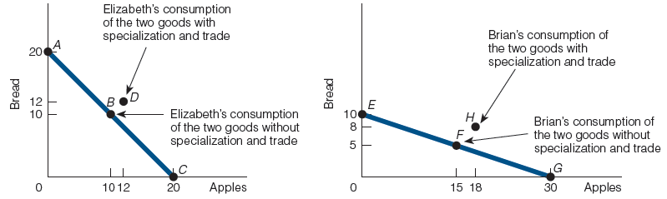
Ex Post
Click to return to “In this Lesson”
© 2014 Cengage Learning. All Rights Reserved. May not be copied, scanned, or duplicated, in whole or in part, except for use as permitted in a license distributed with certain product , service, or otherwise on password-protected website for classroom use

Slide 25

Wall Street Journal
The Wall Street Journal is a is a rich source of information which provides real life examples of micro- and macro economic activities. Check today’s issue to see the most current news.
http://www.wsj.com
© 2014 Cengage Learning. All Rights Reserved. May not be copied, scanned, or duplicated, in whole or in part, except for use as permitted in a license distributed with certain product , service, or otherwise on password-protected website for classroom use

